Slide 1
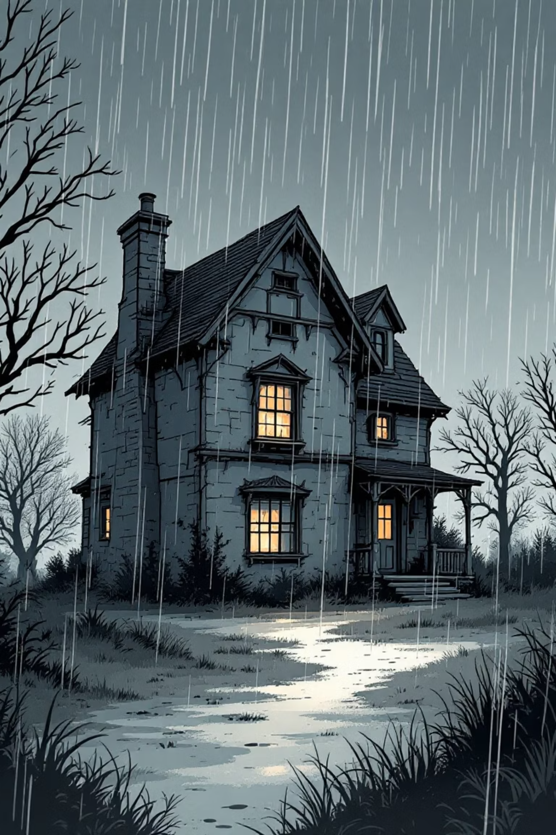
Vanished!
A mysterious story

Slide 2

Shhh... Listen.
Sometimes, things are not what they seem...

Slide 3
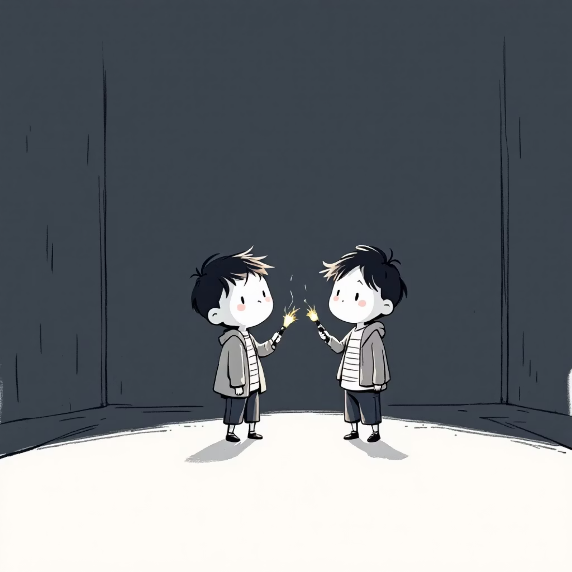
Your Mission, Detectives!
🔎 Investigate a mysterious story.
🗣️ Learn "secret code" words (new vocabulary).
🧩 Uncover a hidden grammar clue.
✍️ Create your own mystery file (write a story).

Slide 4

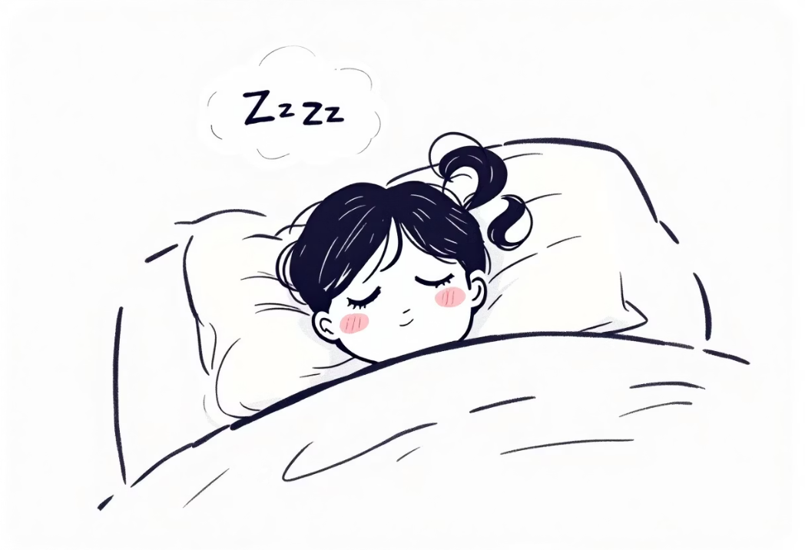
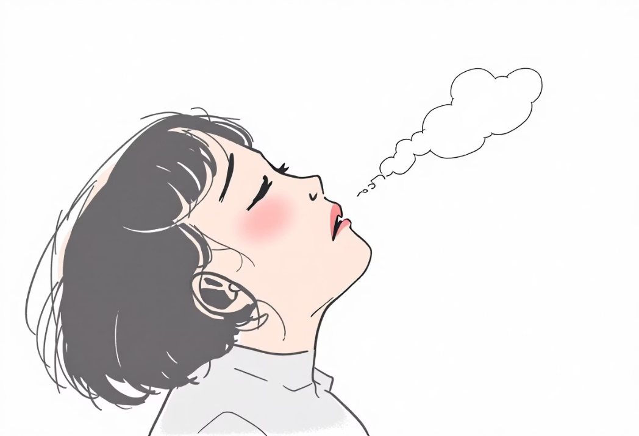
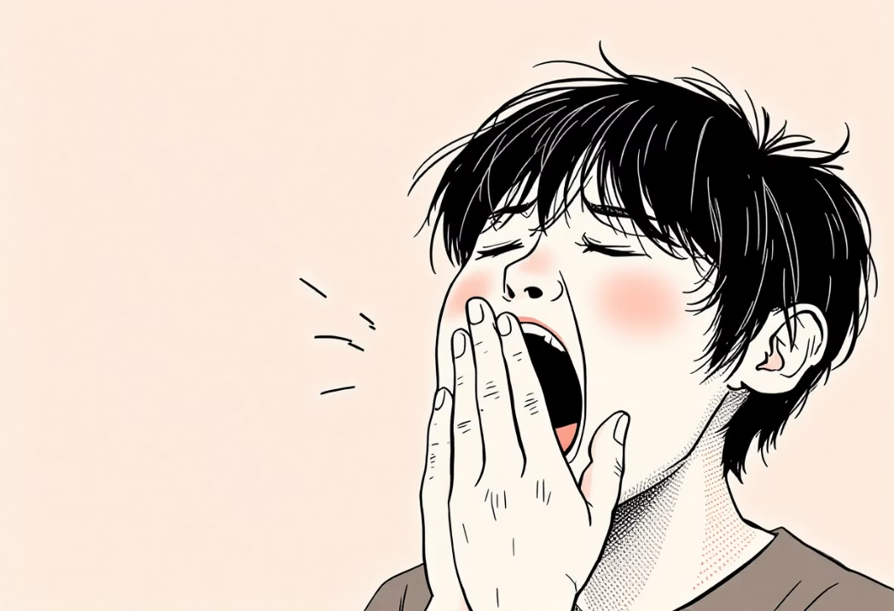
Clue #1: The Sounds of Mystery
GASP
SNORE
SIGH
YAWN

Slide 5

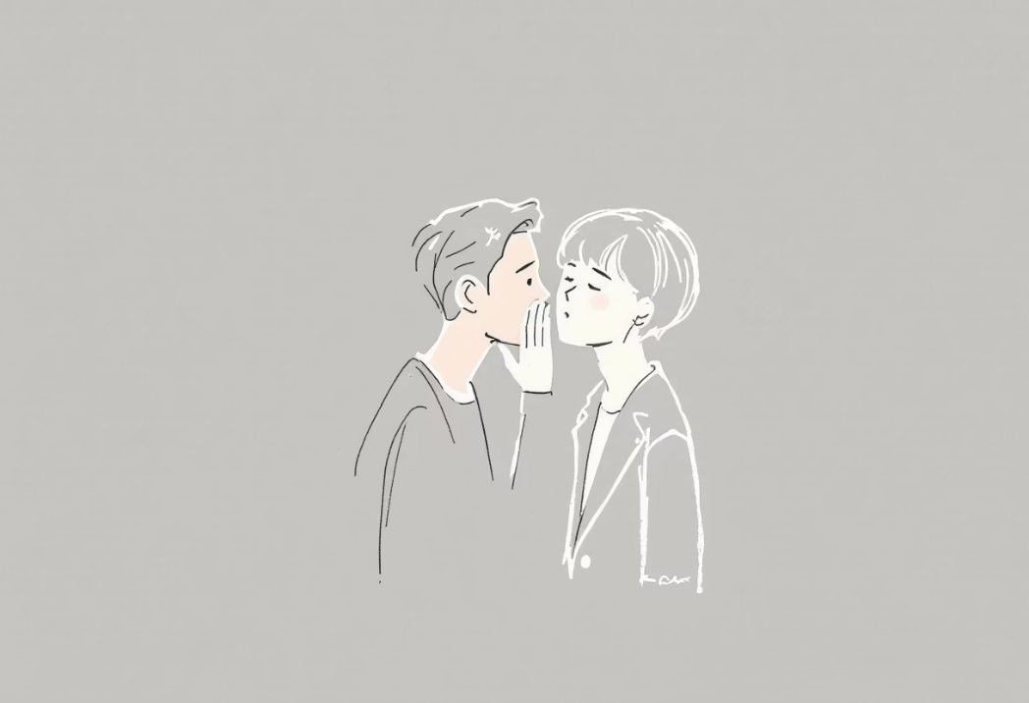
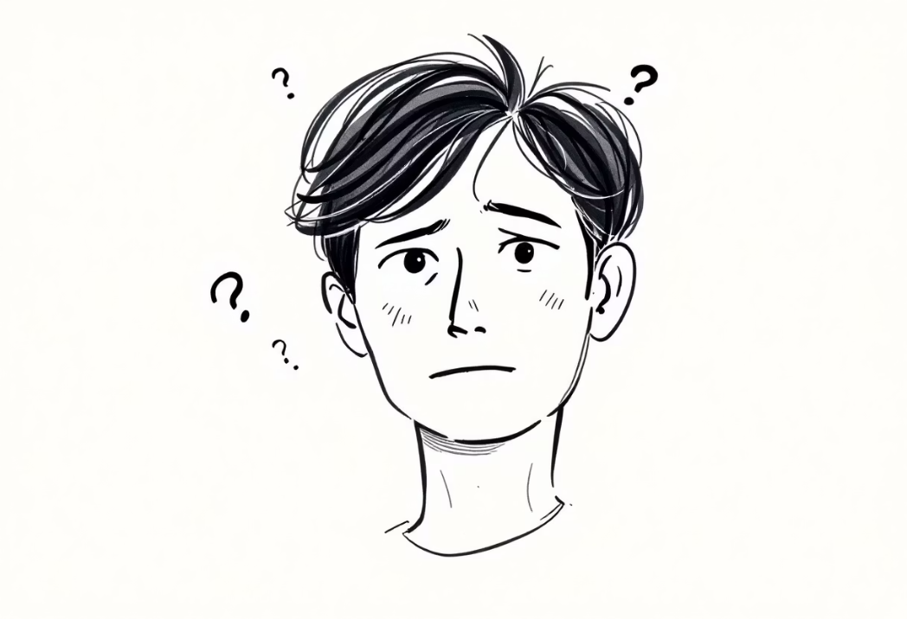
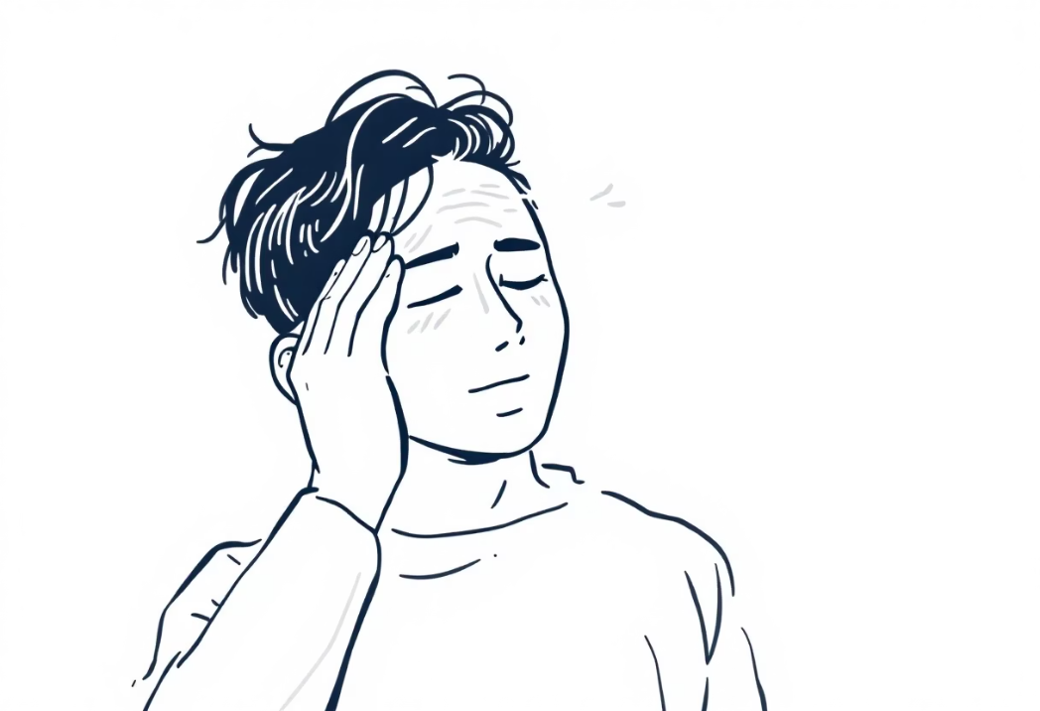
Clue #1 (continued...)
LAUGH
WHISPER
CONFUSED
RELIEVED

Slide 6
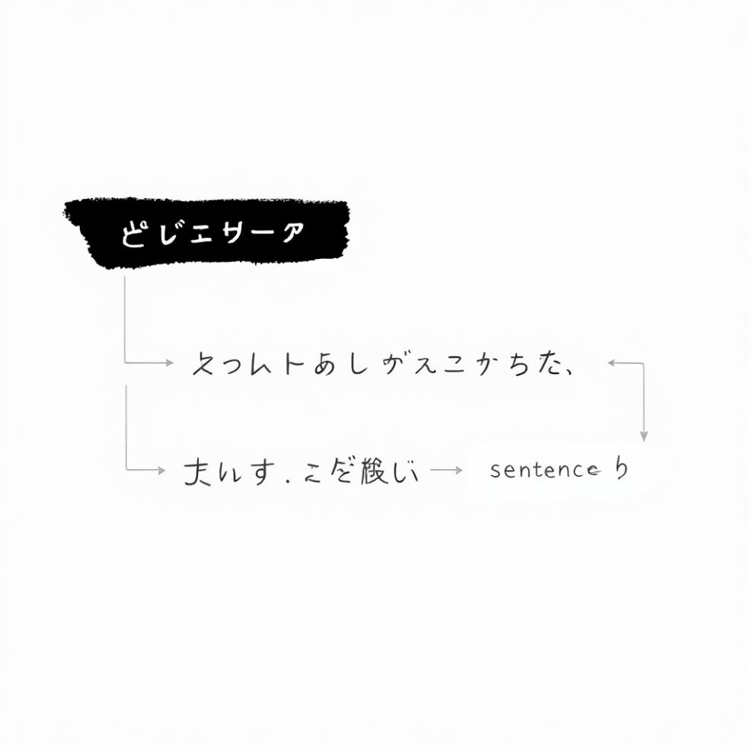
Clue #2: The Grammar Secret - Complex Object
What is it?
With see / hear
We use it to say we see, hear, or want someone to do something.
Formula: Subject + see/hear + Object + Verb (without 'to'!)
No one saw Andy leave the house.
With want / would like
Formula: Subject + want + Object + to + Verb
I want you to listen carefully.

Slide 7
Time to Practice!
Sentence 1
Sentence 2
My mum wants me _____ (to clean / clean) my room.
I saw my friend _____ (to play / play) football.
(Answer appears on click)
(Answer appears on click)

Slide 8

Create Your Own Mystery File!
Write your own mysterious story (about 90 words). Use the plan:
Characters: Who is in your story?
Place & Time: Where and when did it happen?
Events: What happened first? Then?
Climax: What was the most mysterious moment?
Feelings: How did the characters feel? (Confused? Relieved?)

Slide 9
Final Thoughts, Detectives...
Finish one of these sentences in your mind or share it with us:
Today, I felt like a real detective when…
The biggest mystery for me today was…
I am proud of myself because I…
Now I want my friend to…

Slide 10
Your Next Mission (Homework),
Detectives...
Finish one of these sentences in your mind or share it with us.
  Finish your mysterious story. Add a title and an illustration.
like a real detective when…

